Slide 1
Patterning - Photolithography
Oxidation
Photoresist (PR) coating
Stepper exposure
Photoresist development and bake
Acid etching Unexposed (negative PR) Exposed (positive PR)
Spin, rinse, and dry
Processing step Ion implantation Plasma etching Metal deposition
Photoresist removal (ashing)
UV light
mask
SiO₂
PR
Notes:
Same sequence patterns the complete surface of the wafer. Hence it is a very parallel process transferring hundreds of millions of patterns to the wafer surface simultaneously making cheap manufacturing of complex circuits possible.
1 – deposit thin layer of SiO2 by exposing it to a mixture of high-purity oxygen and hydrogen at 1000C
2 – light-sensitive polymer evenly applied while spinning the wafer to a thickness of 1 micron; polymers cross-link when exposed to light making the affected region insoluble (negative PR) or original insoluable, soluable after exposure (positive PR). COST OF MASKS IS INCREASING QUITE RAPIDLY WITH SCALING OF TECHNOLOGY – A REDUCTION OF MASKS IS OF HIGH PRIORITY!
3 – glass mask containing patter brought in close proximity to the wafer. Mask is transparent in regions we want to process and opaque elsewhere (positive PR). Combination exposed to UV light. Where mask is transparent, photoresist becomes soluable. Dimensions of features is approaching the wavelength of optical light sources (we’re good up to 0.1 micron). Will eventually move to X-ray or electron-beam (much less cost effective).
4 – Exposed photoresist is removed in a acid or base wash, then wafer is “soft-baked” to harden remaining PR
5 – Exposed material (SiO2) is removed via acid, base, and caustic solution wash.
6 – SRD – number of dust particles per cubic foot of air in clean room ranges between 1 and 10
8 – high-temperature plasma is used to selectively remove the remaining photoresist

Slide 2
Example of Patterning of SiO2
Chemical or plasma
etch
Hardened resist
Si-substrate
SiO
2
Si-substrate
Silicon base material
4. After development and etching of resist, chemical or plasma etch of SiO₂
Photoresist
SiO₂
Si-substrate
1&2. After oxidation and deposition of negative photoresist
Hardened resist
SiO₂
Si-substrate
UV-light
5. After etching
Patterned
optical mask
Exposed resist
SiO₂
Si-substrate
Si-substrate
3. Stepper exposure
8. Final result after removal of resist

Slide 3
Diffusion and Ion Implantation
Area to be doped is exposed (photolithography)
Diffusion
or
Ion implantation
Notes:
Needed for well, source and drain regions, doping of polysilicon, adjustment of thresholds
Diffusion – wafer placed in quartz tube embedded in a furnace (900 to 1100 C). Gas containing dopant is introduced in the tub. Dopands diffused into the exposed surface both vertically and horizontally. Final dopant concentration is highest at surface and decreases in a gaussian profile deeper in the material
Ion implantation – Dopants are introduced as ions into the material by sweeping a beam of purified ions over the surface - acceleration determines how deep ions will penetrate and the beam current and exposure time determine dosage. Independent control of depth and dosage – ion implantation has largely displaced diffusion. However, has a side effect of causing lattice damage to substrate, so usually follow with an annealing step (wafer heated to 1000C for 15 to 30 minutes and allowed to cool slowly). Heating vibrates atoms and allows the bonds to reform.

Slide 4
Deposition and Etching
Pattern masking (photolithography)
Deposit material over entire wafer
CVD (Si₃N₄)chemical deposition (polysilicon) sputtering (Al)
Etch away unwanted material wet etching dry (plasma) etching
Notes:
Needed for insulating SiO2, silicon nitride (sacrificial buffer), polysilicon, metal interconnect
CVD – chemical vapor deposition uses a gas-phase reaction with energy supplied by heat at around 850C. Use for, eg, silicon nitride
Chemical deposition – used for polysilicon. flow silane gas over the heated wafer (coated with SiO2) at approx. 650C. Resulting reaction produces a non-crystaline material – polysilicon. Followed by an implant step to increase its conductivity.
Sputtering – used for aluminum. Al evaporated in a vacuum, heat for evaporation delivered by e-bam bombarding.
Etching is then used to selectively form patterns (wires, contact holes). Wet etching using acid or basic solutions – hydrofluoric acid buffered with fluoride is used to etch SiO2. Plasma etching becoming more common. Use plasma molecules in heated chamber to “sandblast” the surface. Gives well-defined directionality to the etching action, creating patterns with sharp vertical contours.

Slide 5
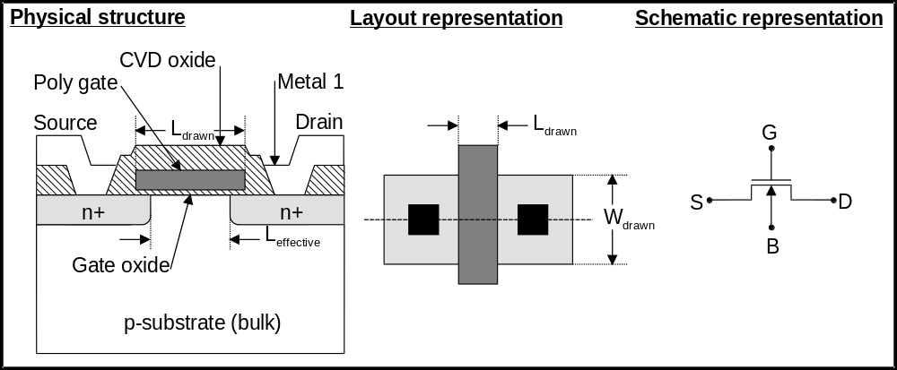
Physical structure
NMOS layout representation:
Implicit layers:
  oxide layers
  substrate (bulk)
Drawn layers:
  n+ regions
  polysilicon gate
  oxide contact cuts
  metal layers
NMOS physical structure:
  p-substrate
  n+ source/drain
  gate oxide (SiO₂)
  polysilicon gate
  CVD oxide
  metal 1
  L_{eff}<L_{drawn} (lateral doping effects)

Slide 6
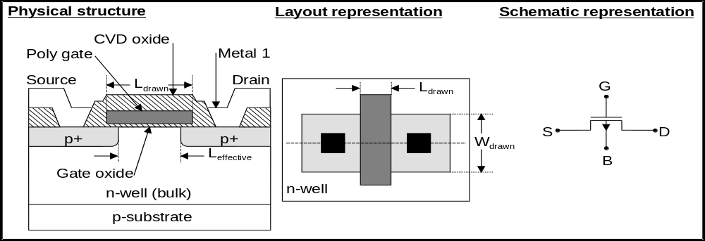
Physical structure
PMOS layout representation:
Implicit layers:
  oxide layers
Drawn layers:
  n-well (bulk)
  n+ regions
  polysilicon gate
  oxide contact cuts
  metal layers
PMOS physical structure:
  p-substrate
  n-well (bulk)
  p+ source/drain
  gate oxide (SiO₂)
  polysilicon gate
  CVD oxide
  metal 1

Slide 7
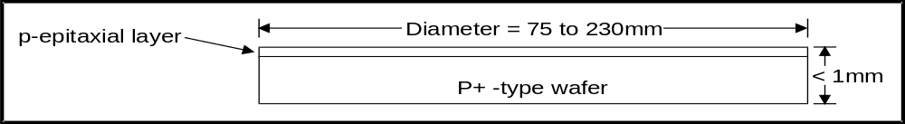
CMOS fabrication sequence
0. Start:
  For an n-well process the starting point is a p-type silicon wafer:
  wafer: typically 75 to 230mm in diameter and less than 1mm thick
1. Epitaxial growth:
  A single p-type single crystal film is grown on the surface of the wafer by:
    subjecting the wafer to high temperature and a source of dopant material
  The epi layer is used as the base layer to build the devices

Slide 8
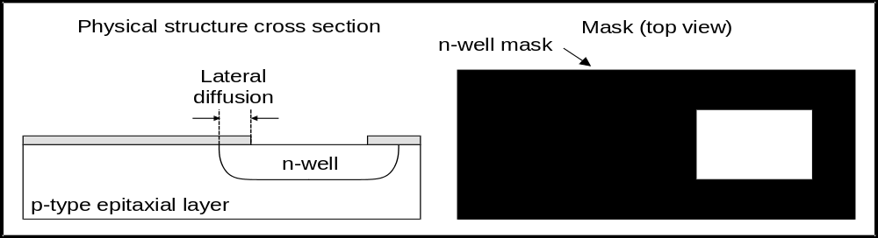
CMOS fabrication sequence
2. N-well Formation:
  PMOS transistors are fabricated in n-well regions
  The first mask defines the n-well regions
  N-well’s are formed by ion implantation or deposition and diffusion
  Lateral diffusion limits the proximity between structures
  Ion implantation results in shallower wells compatible with today’s fine-line processes

Slide 9
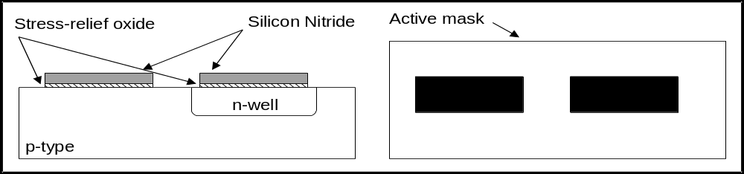
CMOS fabrication sequence
3. Active area definition:
  Active area:
    planar section of the surface where transistors are build
    defines the gate region (thin oxide)
    defines the n+ or p+ regions
  A thin layer of SiO₂ is grown over the active region and covered with silicon nitride

Slide 10
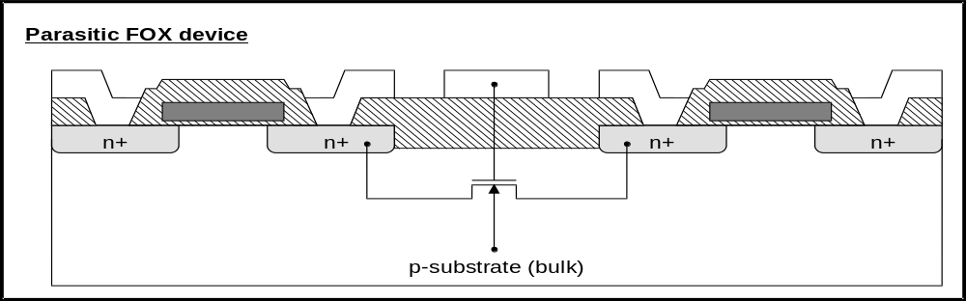
CMOS fabrication sequence
4. Isolation:
  Parasitic (unwanted) FET’s exist between unrelated transistors (Field Oxide FET’s)
  Source and drains are existing source and drains of wanted devices
  Gates are metal and polysilicon interconnects
  The threshold voltage of FOX FET’s are higher than for normal FET’s

Slide 11
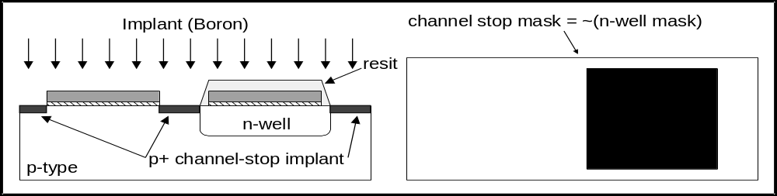
CMOS fabrication sequence
  FOX FET’s threshold is made high by:
    introducing a channel-stop diffusion that raises the impurity concentration in the substrate in areas where transistors are not required
    making the FOX thick
4.1 Channel-stop implant
  The silicon nitride (over n-active) and the photoresist (over n-well) act as masks for the channel-stop implant

Slide 12
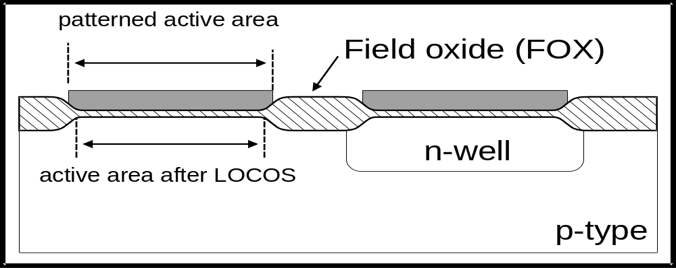
CMOS fabrication sequence
4.2 Local oxidation of silicon (LOCOS)
  The photoresist mask is removed
  The SiO₂/SiN layers will now act as a masks
  The thick field oxide is then grown by:
    exposing the surface of the wafer to a flow of oxygen-rich gas
  The oxide grows in both the vertical and lateral directions
  This results in a active area smaller than patterned

Slide 13
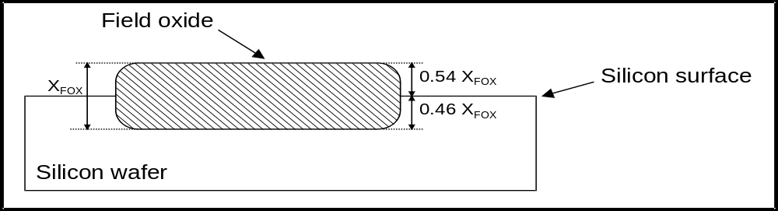
CMOS fabrication sequence
Silicon oxidation is obtained by:
  Heating the wafer in a oxidizing atmosphere:
    Wet oxidation: water vapor, T = 900 to 1000ºC (rapid process)
    Dry oxidation: Pure oxygen, T = 1200ºC (high temperature required to achieve an acceptable growth rate)
Oxidation consumes silicon
  SiO₂ has approximately twice the volume of silicon
  The FOX is recedes below the silicon surface by 0.46X_{FOX}

Slide 14
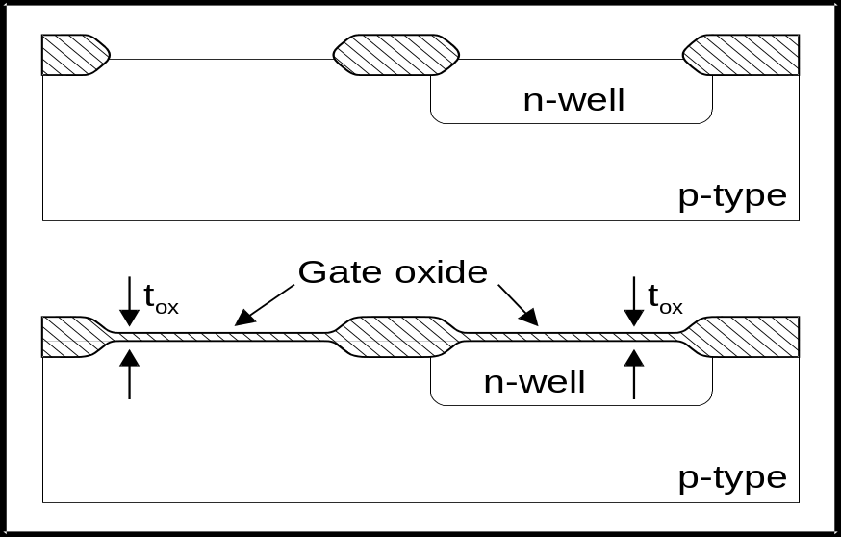
CMOS fabrication sequence
5. Gate oxide growth
  The nitride and stress-relief oxide are removed
  The devices threshold voltage is adjusted by:
    adding charge at the silicon/oxide interface
  The well controlled gate oxide is grown with thickness t_{ox}

Slide 15
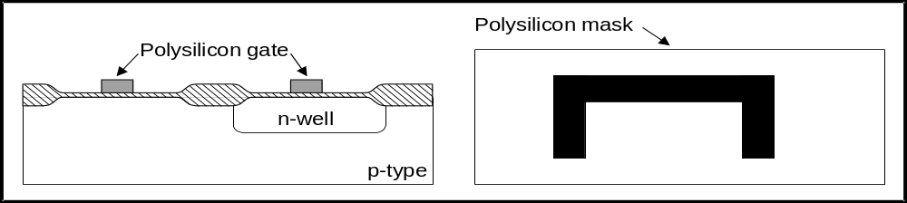
CMOS fabrication sequence
6. Polysilicon deposition and patterning
  A layer of polysilicon is deposited over the entire wafer surface
  The polysilicon is then patterned by a lithography sequence
  All the MOSFET gates are defined in a single step
  The polysilicon gate can be doped (n+) while is being deposited to lower its parasitic resistance (important in high speed fine line processes)

Slide 16
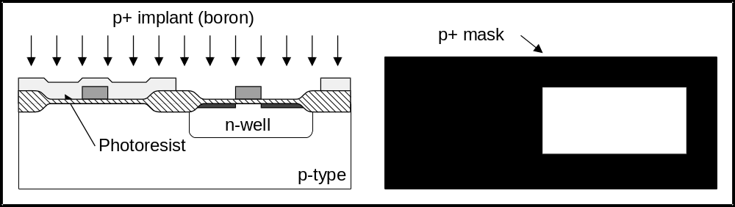
CMOS fabrication sequence
7. PMOS formation
  Photoresist is patterned to cover all but the p+ regions
  A boron ion beam creates the p+ source and drain regions
  The polysilicon serves as a mask to the underlying channel
    This is called a self-aligned process
    It allows precise placement of the source and drain regions
  During this process the gate gets doped with p-type impurities
    Since the gate had been doped n-type during deposition, the final type (n or p) will depend on which dopant is dominant

Slide 17
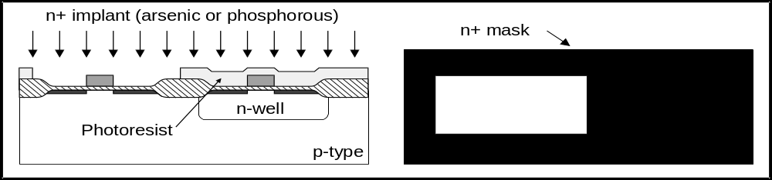
CMOS fabrication sequence
8. NMOS formation
  Photoresist is patterned to define the n+ regions
  Donors (arsenic or phosphorous) are ion-implanted to dope the n+ source and drain regions
  The process is self-aligned
  The gate is n-type doped

Slide 18
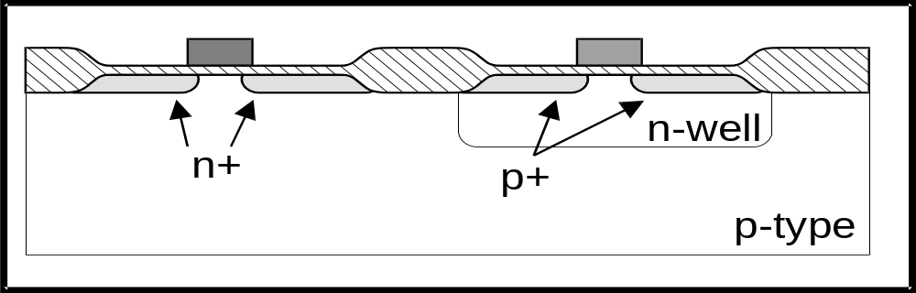
CMOS fabrication sequence
9. Annealing
  After the implants are completed a thermal annealing cycle is executed
  This allows the impurities to diffuse further into the bulk
  After thermal annealing, it is important to keep the remaining process steps at as low temperature as possible

Slide 19
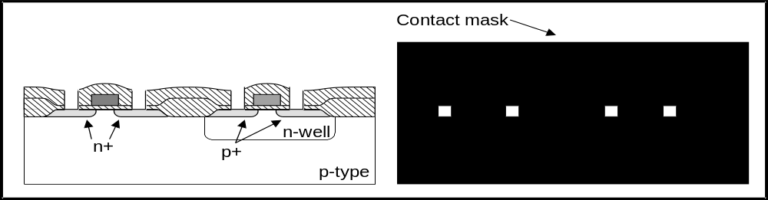
CMOS fabrication sequence
10. Contact cuts
  The surface of the IC is covered by a layer of CVD oxide
    The oxide is deposited at low temperature (LTO) to avoid that underlying doped regions will undergo diffusive spreading
  Contact cuts are defined by etching SiO₂ down to the surface to be contacted
  These allow metal to contact diffusion and/or polysilicon regions

Slide 20
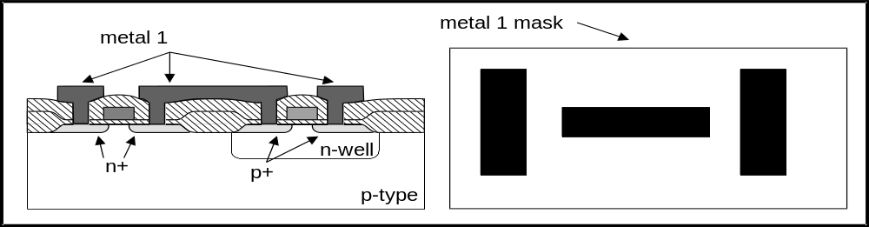
CMOS fabrication sequence
11. Metal 1
  A first level of metallization is applied to the wafer surface and selectively etched to produce the interconnects

Slide 21
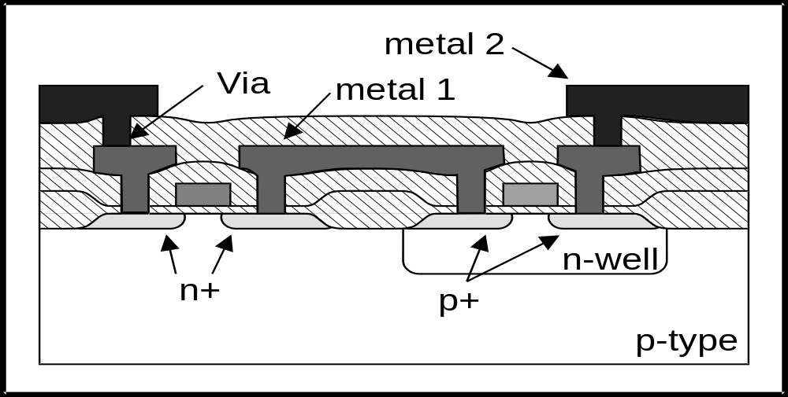
CMOS fabrication sequence
12. Metal 2
  Another layer of LTO CVD oxide is added
  Via openings are created
  Metal 2 is deposited and patterned

Slide 22
CMOS fabrication sequence
13. Over glass and pad openings
  A protective layer is added over the surface:
  The protective layer consists of:
    A layer of SiO₂
    Followed by a layer of silicon nitride
  The SiN layer acts as a diffusion barrier against contaminants (passivation)
  Finally, contact cuts are etched, over metal 2, on the passivation to allow for wire bonding.

Slide 23
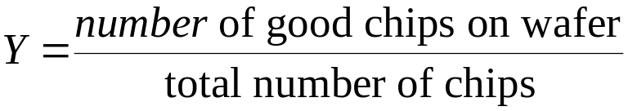
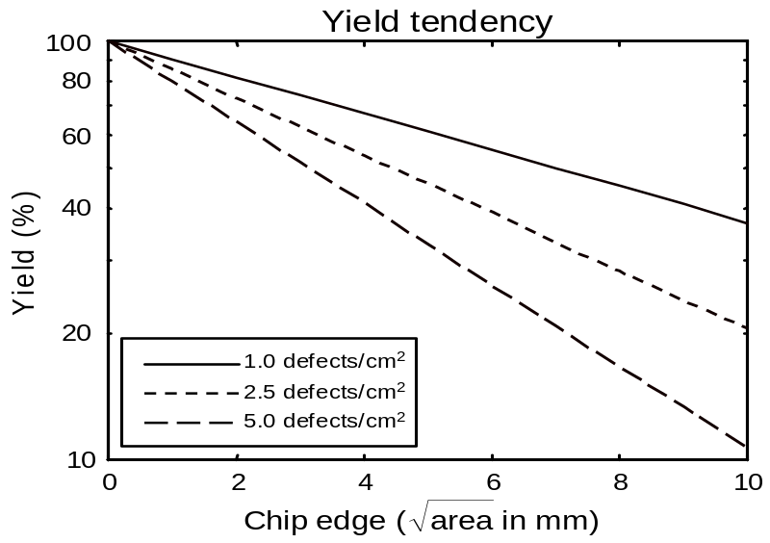

Yield
Yield
The yield is influenced by:
  the technology
  the chip area
  the layout
Scribe cut and packaging also contribute to the final yield
Yield can be approximated by:
  A - chip area (cm²)
  D - defect density (defects/cm²)

Slide 24
Design rules
The limitations of the patterning process give rise to a set of mask design guidelines called design rules
Design rules are a set of guidelines that specify the minimum dimensions and spacings allowed in a layout drawing
Violating a design rule might result in a non-functional circuit or in a highly reduced yield
The design rules can be expressed as:
  A list of minimum feature sizes and spacings for all the masks required in a given process
  Based on single parameter λ that characterize the linear feature (e.g. the minimum grid dimension). λ base rules allow simple scaling

Slide 25
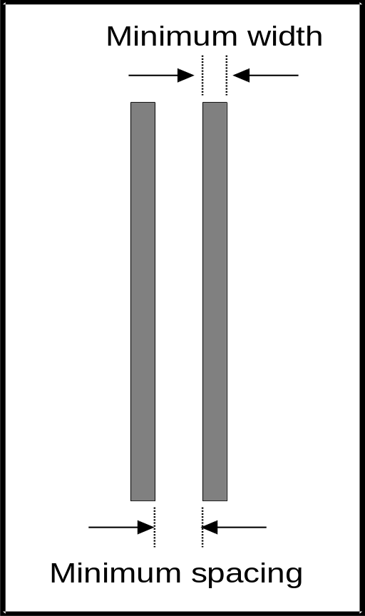
Design rules
Minimum line-width:
  smallest dimension permitted for any object in the layout drawing (minimum feature size)
Minimum spacing:
  smallest distance permitted between the edges of two objects
This rules originate from the resolution of the optical printing system, the etching process, or the surface roughness

Slide 26
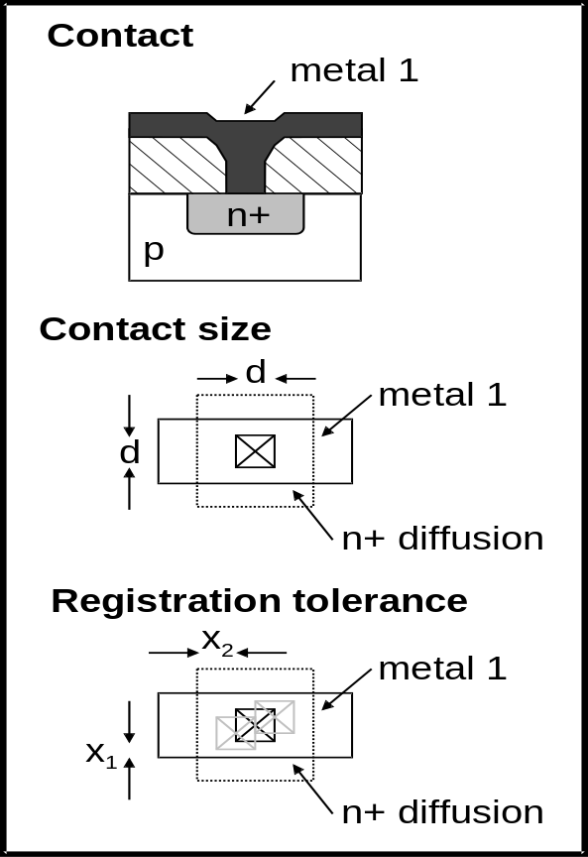
Design rules
Contacts and vias:
  minimum size limited by the lithography process
  large contacts can result in cracks and voids
  Dimensions of contact cuts are restricted to values that can be reliably manufactured
  A minimum distance between the edge of the oxide cut and the edge of the patterned region must be specified to allow for misalignment tolerances (registration errors)

Slide 27
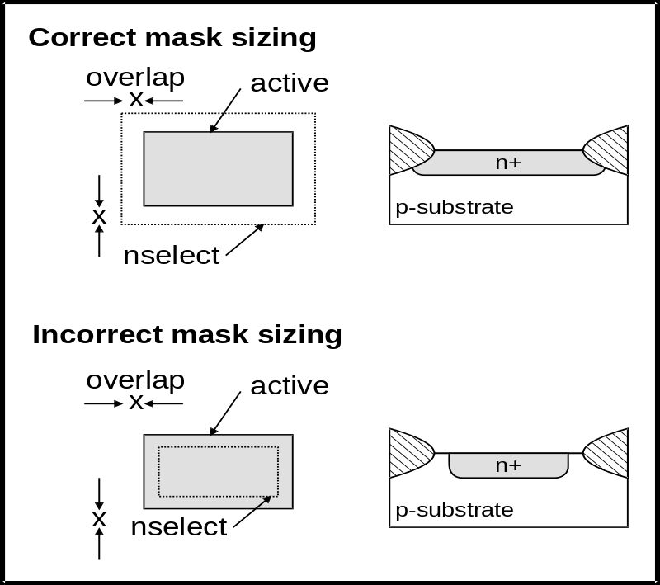
Design rules
MOSFET rules
  n+ and p+ regions are formed in two steps:
    the active area openings allow the implants to penetrate into the silicon substrate
    the nselect or pselect provide photoresist openings over the active areas to be implanted
  Since the formation of the diffusions depend on the overlap of two masks, the nselect and pselect regions must be larger than the corresponding active areas to allow for misalignments

Slide 28
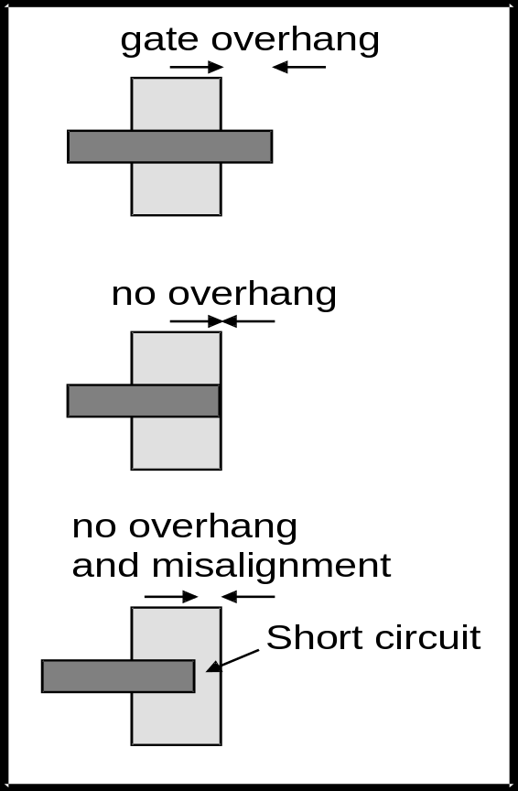
Design rules
Gate overhang:
  The gate must overlap the active area by a minimum amount
  This is done to ensure that a misaligned gate will still yield a structure with separated drain and source regions
A modern process has may hundreds of rules to be verified
  Programs called Design Rule Checkers assist the designer in that task

Slide 29
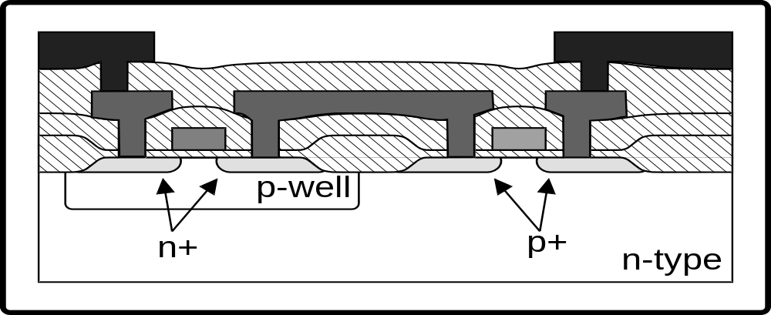
Other processes
P-well process
  NMOS devices are build on a implanted p-well
  PMOS devices are build on the substrate
  P-well process moderates the difference between the p- and the n-transistors since the P devices reside in the native substrate
  Advantages: better balance between p- and n-transistors

Slide 30
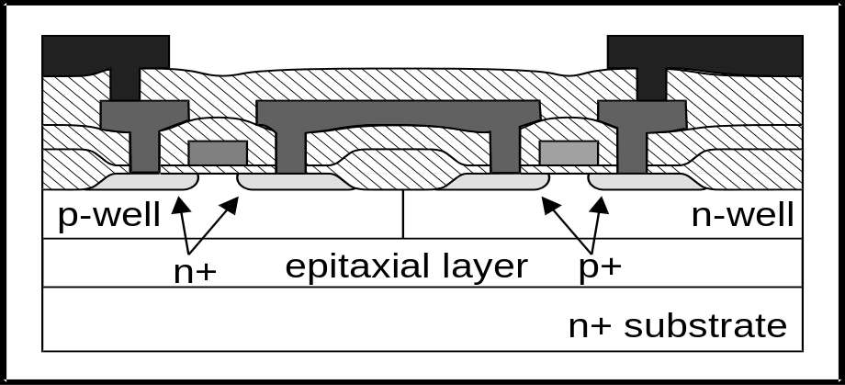
Other processes
Twin-well process
  n+ or p+ substrate plus a lightly doped epi-layer (latchup prevention)
  wells for the n- and p-transistors
  Advantages, simultaneous optimization of p- and n-transistors:
    threshold voltages
    body effect
    gain

Slide 31
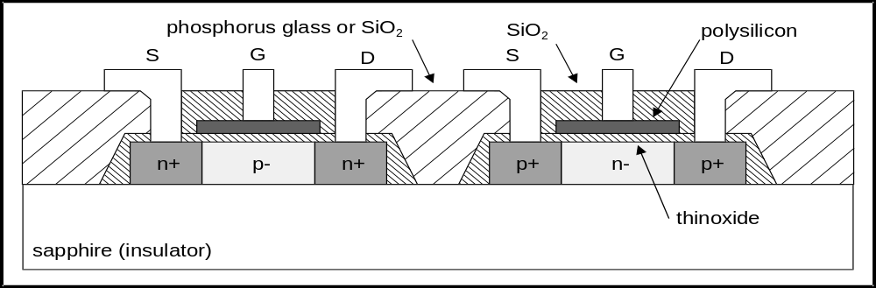
Other processes
Silicon On Insulator (SOI)
  Islands of silicon on an insulator form the transistors
Advantages:
  No wells ⇒ denser transistor structures
  Lower substrate capacitances

